Slide 1
Vietējās pašvaldības un pašvaldību sadarbība Norvēģijā
«En selvstendig og nyskapende kommunesektor»

Slide 2
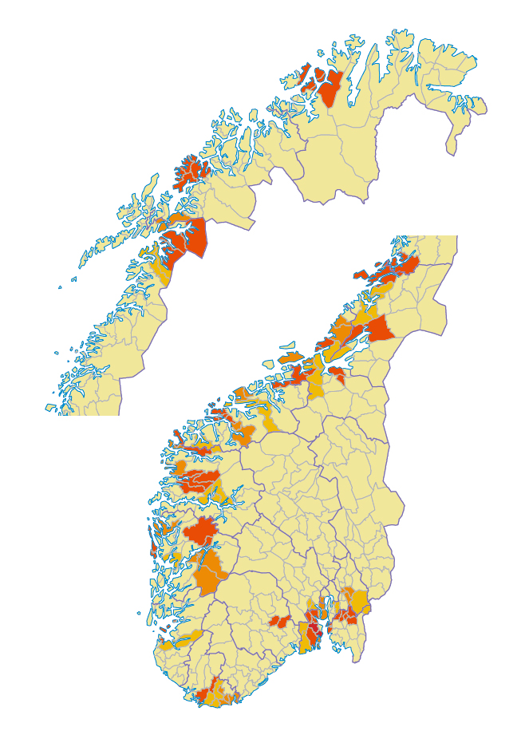
Reformas REZULTĀTI
119 pašvaldības apvienotas
2020. gada 1. janvāris
356 pašvaldības
Ļoti dažāda pašvaldību struktūra
… 47jaunās pašvaldībās
Gandrīz 1/3 iedzīvotāju dzīvo kādā jaunā pašvaldībā
Pašvaldību skaita samazinājums par 17 %
Notes:
422 to 356
18 to 11
Why reform – small municip, outdated borders, more complex challenges
Good, equal services
Comprehensive and coordinated community development
Sustainable and financially solid municipalities
Strengthened local democracy

Slide 3
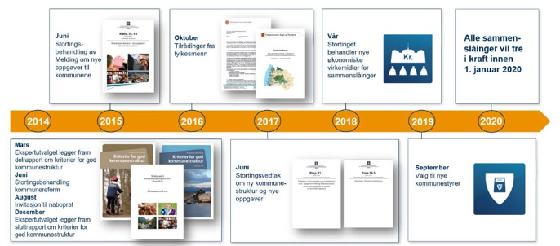
Reformas laika grafiks
Notes:
2014 – expert committee new municipalities – structure and resposnibilities
2015 – white papaer new tasks and responsibilities – few new tasks decided
Local councils encouraged to start dialogues for merging processes
2016 – reports from all county governors (regional state) on recommendations for merging processes and status for the councils dialogues
2017 – Parliament decided the new municipal structure – and recommendations for new regions
2018 – government proposed extended municipal reform – further economic incentives
2019 – local elections new municipal councils / county councils
2014 - 2016 Local discussions
Summer 2016 Municipal Resolutions, July 1st

Slide 4
Programmas organizācija — piemērs Midt-Telemark
Politiskā koordinācijas komisija
Administrācijas komiteja
Programmas izpilddirektors
Politiskā
darba grupa
r
Arodbiedrību pārstāvji
Programmas vadītājs
Programmas vadības grupa
Informācija/personāls
1. projekts
Pers. un org. izstrāde
2. projekts
Ekonomika
3. projekts
Veselība un aprūpe
4. projekts
Skolas un izglītība
5. projekts
Infrastruktūra
6. projekts
Plāni un attīstība
7. projekts
Digitalizācija
Darba pakotne
Darba pakotne
Darba pakotne
Darba pakotne
Darba pakotne
Darba pakotne
Darba pakotne
Darba pakotne
Darba pakotne
Darba pakotne
Darba pakotne
Darba pakotne
Darba pakotne
Darba pakotne
Darba pakotne
Darba pakotne
Darba pakotne
Darba pakotne
Darba pakotne
Darba pakotne
Darba pakotne
Notes:
Advice to municipalities –
Common political committee
Social partners committeee
Project organisation
Restructuring agreement

Slide 5
IMC Trøndelag reģionā
Izpētes ziņojumi 2009., 2012. un 2021. g.
No 2 novadiem uz 1
No 48 pašvaldībām uz 38
289 IMC, par 60 mazāk
Vidēji 35 katrā pašvaldībā

Slide 6
Brīvība organizēt pakalpojumus
Pašvaldības struktūrā
Pašvaldības uzņēmums
Atsevišķa juridiska persona
Pirkt pakalpojumus
No privātiem uzņēmumiem
No bezpeļņas organizācijām
Foto: ScanStockPhoto
Notes:
Kommuner og fylkeskommuner har stor frihet til å organisere virksomheten slik de finner det hensiktsmessig. – Enten gjennom egen driftsorganisasjon, interkommunalt samarbeid, etablere selvstendige rettssubjekter eller kjøpe tjenestene. Imidlertid er ikke denne friheten uten rammer. De mest vanlige organiseringsformene er lovregulert. Som folkevalgt er det viktig at du er klar over at det er kommunestyret eller fylkestinget som har det overordnede ansvaret for oppgaveløsningen, uavhengig av hvordan virksomheten er organisert.
De fleste kommuner kjøper tjenester av private, og noen kommuner kjøper tjenester fra ideelle organisasjoner.

Slide 7
Panākumu kritēriji
Tikšanās vietas
Apņēmība īstenot kopīgu redzējumu
Stratēģija
Labi sadarbības projekti ar reāliem un acīmredzamiem rezultātiem
Uzsvars uz īstenošanu
Panāktajam izmaksu ietaupījumam nepieciešams laiks
Uzticība, cieņa, konsenss un savstarpējība
Notes:
As each relationship, also intermunicipal cooperation, needs some «investment». It is important to use time and good materials for the foundation when we build the house, so it is with cooperation as well.We need good and open discussions about the goals of cooperation and which type and model suits us best. In order to reach this common understanding we can use electronic means, but we also need to meet with colleagues physically. It takes time to reach commitment for the joint vision, to work out strategy and work plans. Choise of good cooperation projects with obvious and realistic results is very important.
Agreements with clear roles and responsibilities, rutines and procedures help a lot both in good and bad times.
But as all cooperation - it is about relationship between people. It is about trust, respect, consensus and mutuality. And WILL. Without will to find joint solutions, will to invest in the cooperation and will to accept and tolerate our partners, would be difficult to establish well functioning cooperation.

